Slide 1

MATLAB Matrices: Enter a Matrix
Professor Bo Liu
James Watt School of Engineering

Slide 2
Matrices
Matrices are used to store multiple values together as a single variable.
Matrices can be:
  one dimensional e.g., arrays (or vector).
  two dimensional e.g., matrices.
  n dimensional e.g., tensors.
Matrices can be created via:
  Manual entry.
  Using built-in functions.
  Loaded from external files.

Slide 3
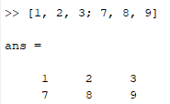
Matrices: manual entry
Matrices are created using square brackets
  Elements in the same row are separated with a comma
  A semicolon tells MATLAB to start a new row.
Entering a matrix manually.
  e.g., [1, 2, 3; 7, 8, 9].
See live script

Slide 4
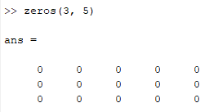
Matrices: from zeros function
Create a matrix of m rows and n columns with all elements as 0
  zeros(m, n).
  Example: m = 3, n = 5
See live script

Slide 5
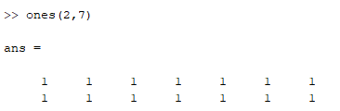
Matrices: from ones function
Create a matrix of m rows and n columns with all elements as 1
  ones(m, n).
  Example: m = 2, n = 7
See live script

Slide 6
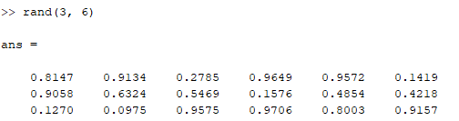
Matrices: from rand function
Create a matrix of m rows and n columns with all elements uniformly distributed random floating-point numbers between 0 and 1
  rand(m, n).
  Example: m = 3, n = 6
See live script

Slide 7
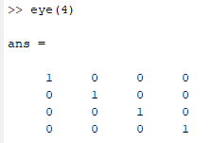
Matrices: from eye function
Creates a square identity matrix of m rows and columns
  eye(m).
  Example, m = 4
See live script

Slide 8
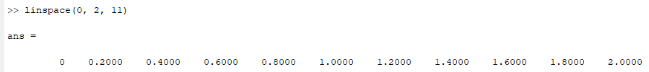
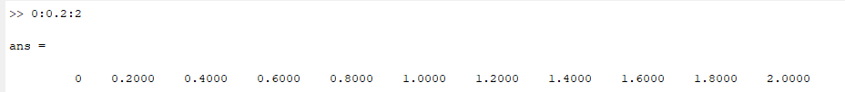
Matrices: linspace
Create a 1-dimensional linearly spaced matrix of n elements between x1 and x2
  linspace(x1, x2, n).
  Example: x1 = 0, x2 = 2, n = 11
This can also be achieved using the colon operator to indicate the start, increment and end.
  Example 0:0.2:2
See live script

Slide 9




Thanks!
#UofGWorldChangers
@UofGlasgow

Slide 10
Matrices: from built-in functions
Function | Description
zeros(m, n) | Creates a matrix of m rows and n columns where each element is 0
ones(m, n) | Creates a matrix of m rows and n columns where each element is 1
eye(m) | Creates the square identity matrix with m columns and rows
rand(m, n) | Creates a matrix of m rows and n columns where each element is a uniformly randomly distributed floating point number between 0 and 1
linspace(x1, x2, n) | Creates a row vector of n linearly spaced elements between x1 and x2
See live script

